Slide 1

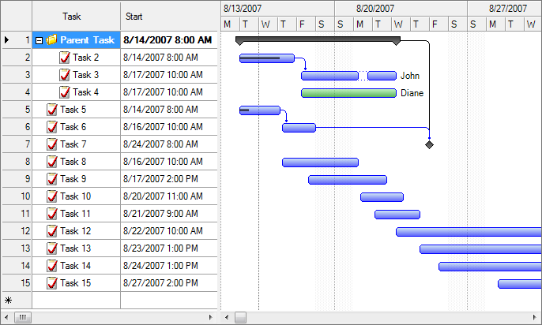
Project Scheduling
MGMT-3105
Lecture 8
G. Labbé & R.W. Schott

Slide 2


Slide 3
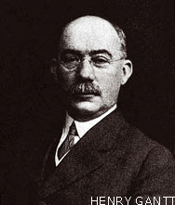
Gantt charts
Developed by Henry Gantt (1861-1919) between 1910 and 1915, they are another extremely useful tool for showing a project network.
Gantt charts establish a time-phased network, which links project activities to a project schedule
You need to understand the appropriate use of them and how to read/make them.
On which project was the Gantt chart heavily utilized for the first time between 1931 and 1936?
The Hoover Dam (Nevada–Arizona border)

Slide 4
Gantt Charts
When they are linked to a project schedule, they can be used to
track the progress of the project against its plan.
Some of the benefits of Gantt Charts are:
They are easy to read and comprehend
They identify the project network coupled with the schedule
They allow for updating and project control
They are useful for assigning resources to tasks
They are also easy to create.

Slide 5
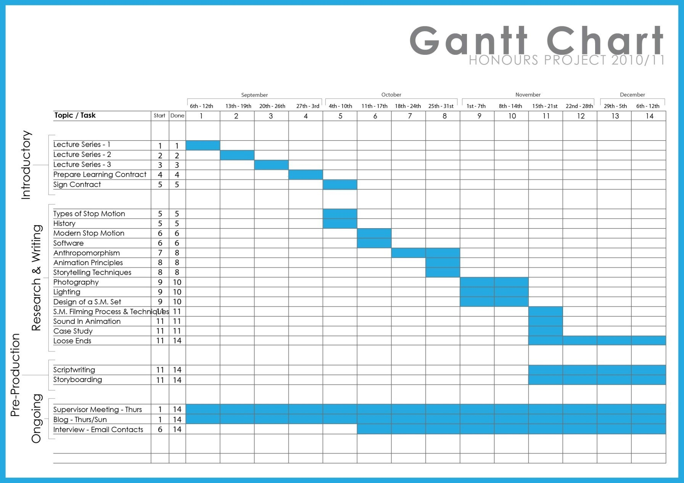
Example Gantt Chart Formats
Simple
No Resources

Slide 6

Example Gantt Chart Formats
Now Add Resources

Slide 7
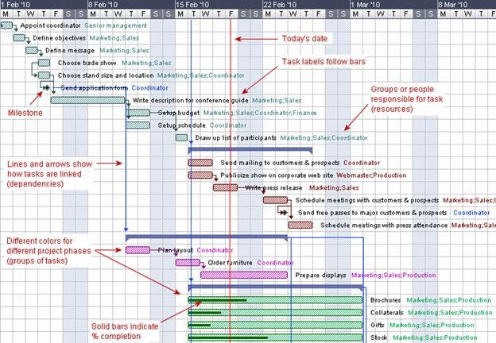
Example Gantt Chart Formats
Now Get Really Crazy!

Slide 8
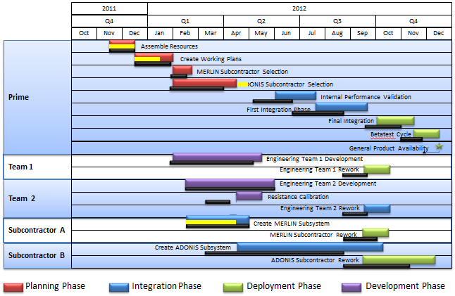
Example Gantt Chart Formats
Completely Different.

Slide 9
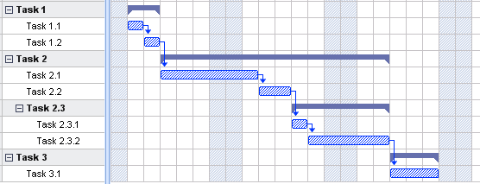
Gantt chart formats
Gantt charts allow you to show precedence and successors within tasks.

Slide 10



Gantt chart formats
Arrows show the order tasks must be completed
Tasks can have more then one preceding task.
Completing a task can lead to the
Start of two or more tasks.

Slide 11
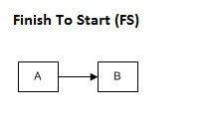
Precedence Relationships
Finish To Start (FS) Relationship:
The second activity can not be started until the first activity completes. It is the most used dependency.
Example:
To paint a wall first you need to build a wall. In this case, first activity is building the wall and second activity will be painting. You can not start painting the wall unless the wall is ready

Slide 12
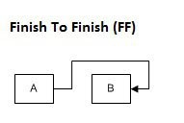
Precedence Relationships
Finish To Finish (FF) Relationship:
The second activity cannot be finished until the first activity finishes.
Example:
You can not finish editing a paper until the paper has finished being written.

Slide 13
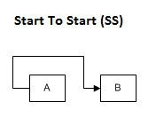
Precedence Relationships
Start To Start (SS) Relationship:
The second activity cannot be started until the first activity starts; both activities should start simultaneously.
Example:
To cut the grass you need to trim around areas the lawn mower can not get to as well as cut the lawn. Both activities can be started at the same time.

Slide 14
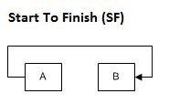
Precedence Relationships
Start To Finish (SF) Relationship:
The start of the first activity triggers the finish of the second activity. (VERY UNCOMMON)
Example:
The start of the new shift signals the finish of the current shift. Current shift can't end until the new one starts.

Slide 15
CRASHING PROJECTS (UNDER WHAT conditions)?
The initial schedule may be too optimistic.
Market needs change and the project is in demand earlier than anticipated.
The project has slipped considerably behind schedule.
The contractual situation provides even more incentive to avoid schedule slippage.

Slide 16
Options for Accelerating Activities
Improving the productivity of existing project resources (team meeting to focus efforts on the most important aspect of a task. Review best practice how to do the task)
Changing the working method employed for the activity, usually by altering the technology and types of resources employed (Change from drawing review to CAD model review)
Increasing the quantity of project resources, including personnel, plant, and equipment (OT, extra shifts, expedite freight)…

Slide 17
Caution with requesting (excessive) overtime!
There is research that suggests that the greater the amount of overtime workers are expected to perform, the lower the marginal performance a company is likely to receive from them.
For example, it was found that in engineering functions, optimal performance was realized after only four hours of overtime per week.
By the time engineers were working 10 hours of overtime, the marginal real extra output realized by the company had dropped to zero!

Slide 18
Time-Cost Trade offs for Crashing Activities

Slide 19
CRASHING ACTIVITIES – AN EXAMPLE
Formula
SUPPOSE:
NORMAL ACTIVITY DURATION = 8 WEEKS
NORMAL COST = $14,000
CRASHED ACTIVITY DURATION = 5 WEEKS
CRASHED COST = $23,000
THE ACTIVITY COST SLOPE =
23,000 – 14,000 or, $9,000 = $3,000 per week
8 – 5 3

Slide 20
CRASHING ACTIVITIES – AN EXAMPLE
Project cost changes when tasks along the critical path are being crashed.
The cost goes up for every task being crashed.
One can create a table listing all tasks, the normal duration and cost, and the
crashed duration and cost.
With this table it is possible to calculate the crashing cost per day for each
task and select the task that makes the most financial sense to crash.
Tasks A, F and H are on the critical path.

Slide 21
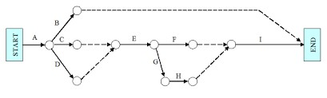
The Network Diagram
C
4
The above is an example of an Activity-on-Arrow diagram (AOA).
Activity is on the arrow. Length of arrow denotes time. Easier to visualize passage of time.
Dashed lines are dummy tasks – to show Finish-to- start.
Node shows earliest and latest start.

Slide 22
Downside to Network Diagrams
May not be drawn to scale – time is just a number so can lead to a perception of more time than actually available.
Can be too large and complex to really be useful.
Faulty reasoning in network construction can sometimes lead to oversimplification or incorrect representations.
Networks are sometimes used for tasks which they are not well suited
When estimating there is a strong potential for positive bias in PERT estimations.

Slide 23
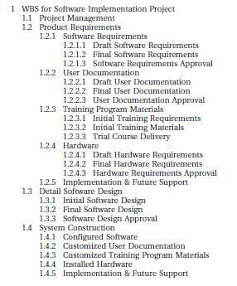
Create an AON diagram from this WBS
http://herdingcats.typepad.com/.a/6a00d8341ca4d953ef0133f339b8a9970b-pi

Slide 24

First Draft AON Example

